Slide 1

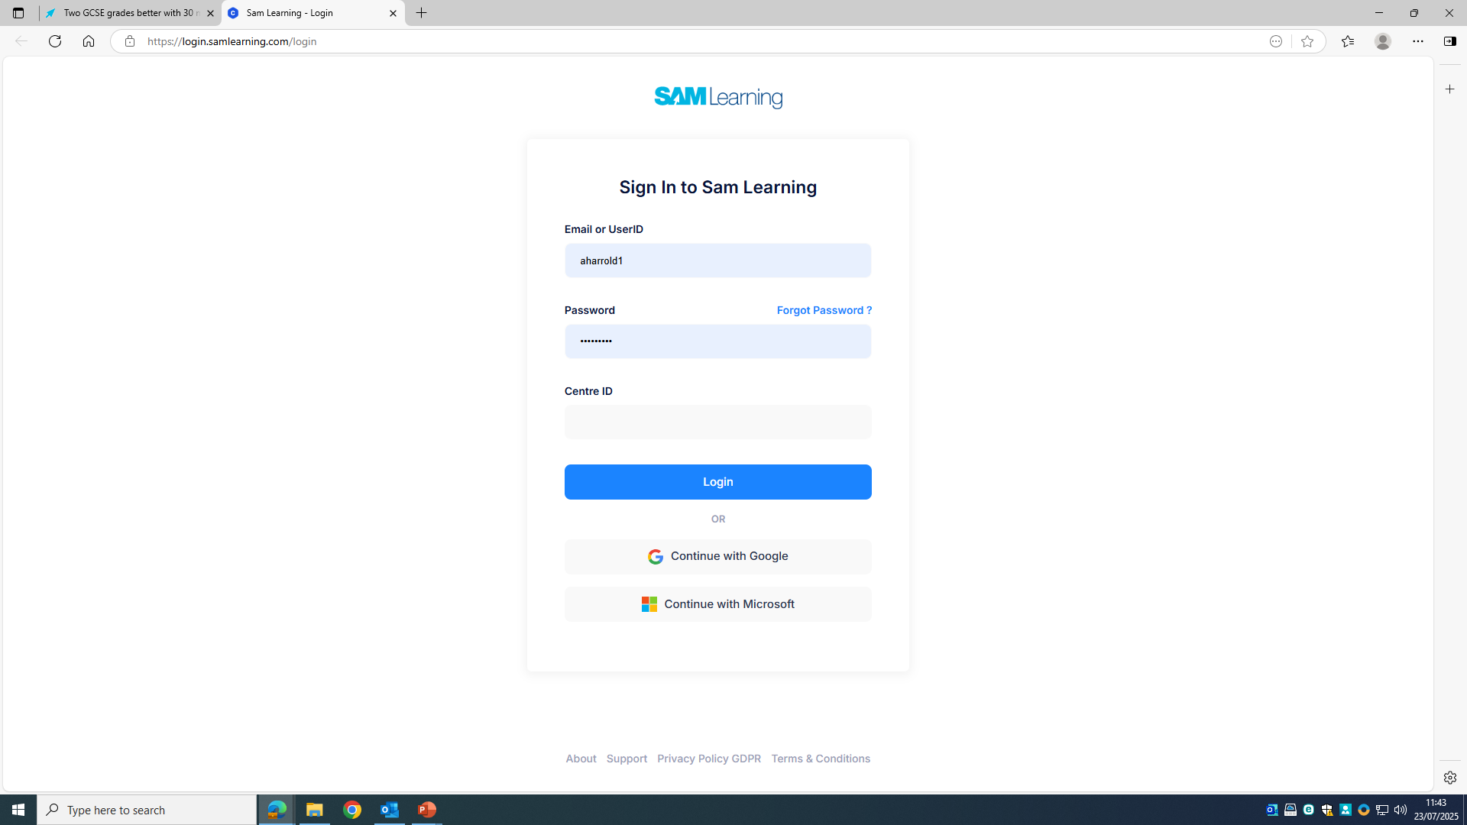
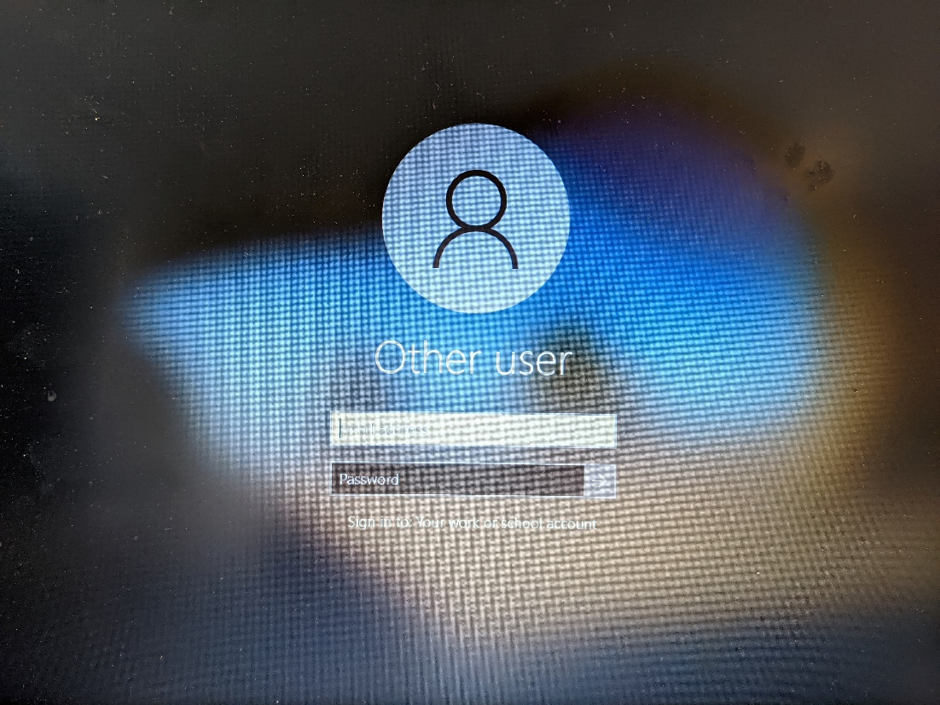
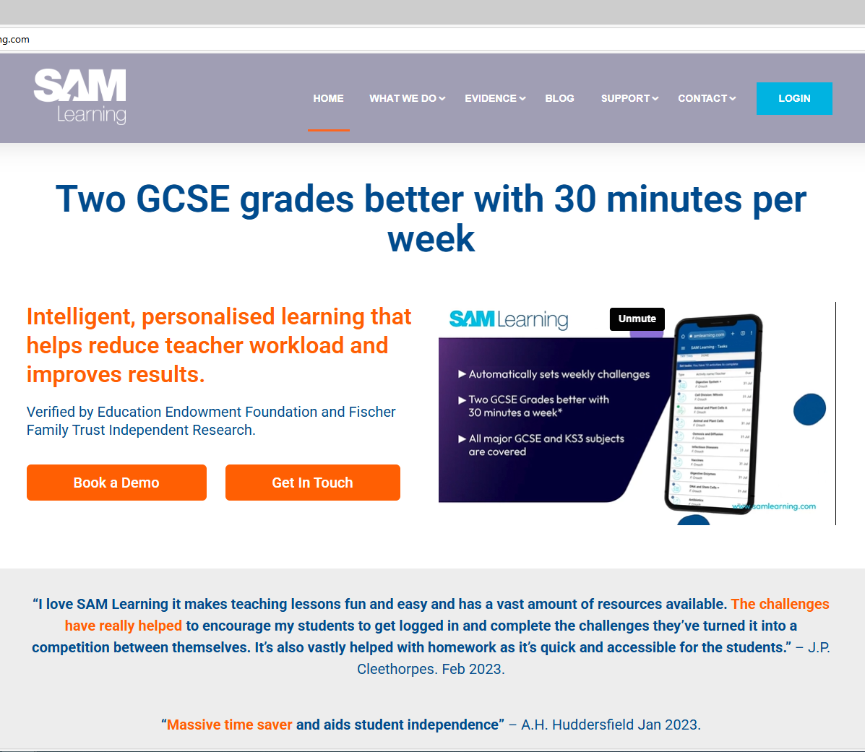
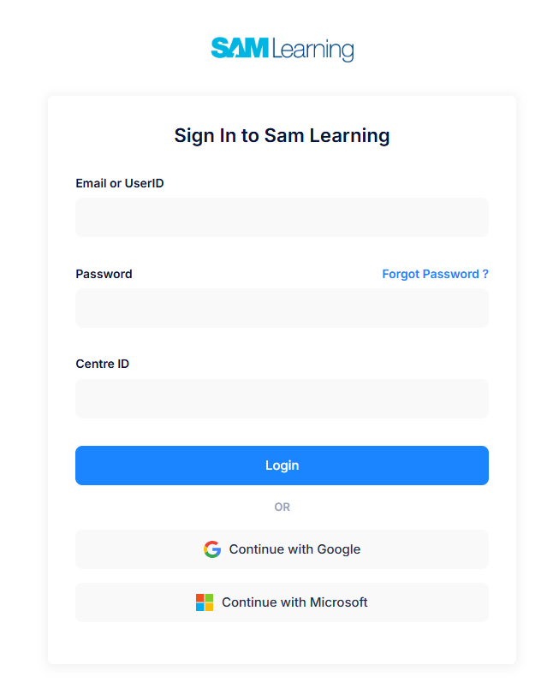
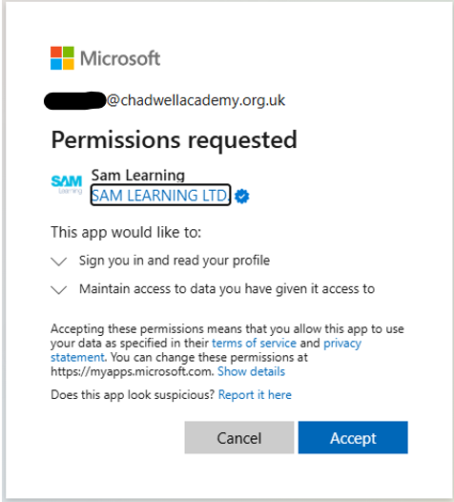
How do I login at school?
1. Log into your school account
2. Go to the SAM Learning website – Click LOGIN
3. Click – Continue with Microsoft
4. If this is your first time using the platform or using the new single sign on, then Click on Accept
https://www.samlearning.com
No need for a User ID / Password or Centre ID! Just a Click of a button!!

Slide 2
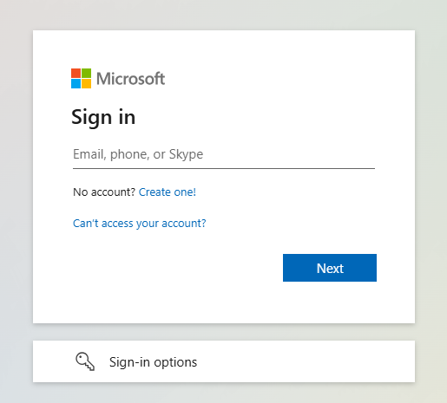
How do I login at home?
1. Go to the SAM Learning website – Click LOGIN
2. Click – Continue with Microsoft
3. Enter your school email and password
These are the same login details you use when signing into your school account at home or Satchel account
Username:
0000@chadwellacademy.co.uk
Password: is the same password you use to log into the school computer
https://www.samlearning.com

Slide 3
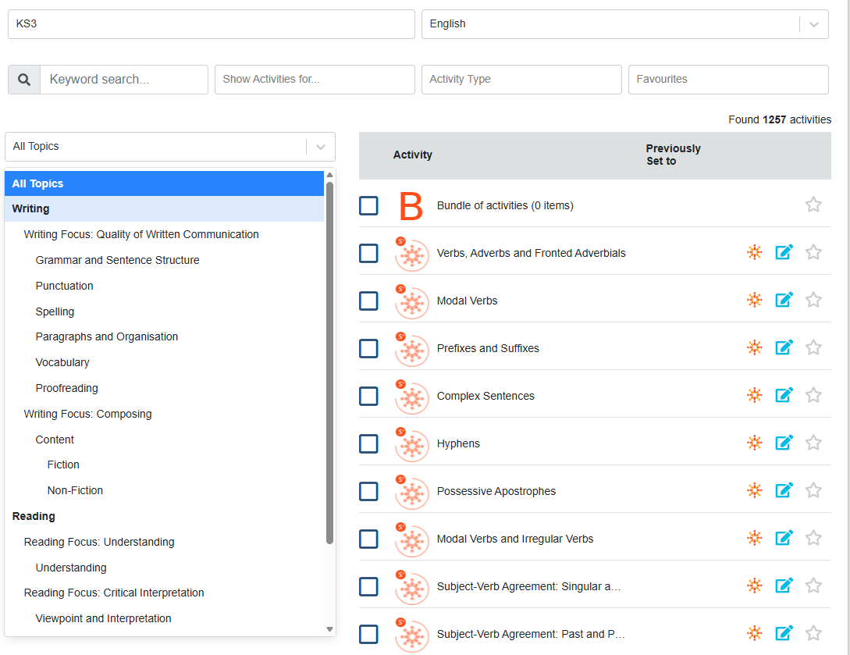
Year 7 English Activity
KS3
English
Modal Verbs

