Slide 1
Making the Revision Timetable- when will I study what?
Start by identifying areas in each subject that you want to revise. You will then need to create a Revision Timetable
I want to average between 2 and 3 hours per day
It will really help to ensure that I revise all the things I need to properly, if I have organised a revision timetable
Time | Thursday | Friday
5-6 (incl 15 min break) | History- The causes of the Boom | D&T catering- food groups
6-7(incl 15 min break) | Maths- percentages and ratios
7-8 | Watch TV | Out with Friends
8-9(incl 15 min break) | Chemistry- balancing equations | Out with Friends
Make specific plans- Tonight I have decided to look at the ‘Causes of the Boom in America in the 1920s’ between 5 and 6
I will need breaks. 45 minutes is probably all I can revise at a time. I will reward myself with a night off on Friday because I have worked well this week.
Tip: I can get some good work done on Saturday and Sunday morning when I am fresh. This reduces the pressure on other times

Slide 2




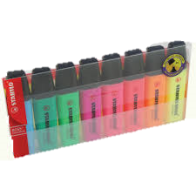
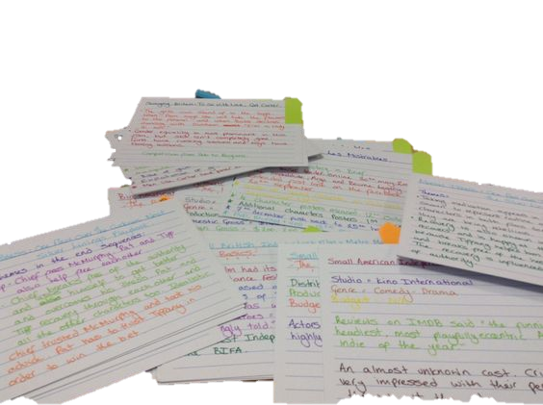


Successful Revision: Setting Up
Spare Revision Cards
A Cup of Tea and a Biscuit
NO mobile phone!!
Highlighter Pens
Pens/pencils etc
Revision Guides
Exercise Book/Notes
Revision notes

Slide 3
Why Had A Boom Occurred in America in the 1920s?
1. The First World War
For most of the First World War the USA followed a policy of isolationism- they did not want to be involved in the war. During this time America made lots of money selling weapons to Britain and France, it also took over the markets around the world previously supplied by Britain and Germany (They were busy building weapons and fighting rather than trading) and made big profits. They also loaned large amounts of money to Britain and France which had to be paid back with interest.
America also suffered virtually no damage to its resources from the war and this left it comparatively stronger than her European competitors after the war.
Why Had A Boom Occurred in America in the 1920s?
1. The First World War
For most of the First World War the USA followed a policy of isolationism- they did not want to be involved in the war. During this time America made lots of money selling weapons to Britain and France, it also took over the markets around the world previously supplied by Britain and Germany (They were busy building weapons and fighting rather than trading) and made big profits. They also loaned large amounts of money to Britain and France which had to be paid back with interest.
America also suffered virtually no damage to its resources from the war and this left it comparatively stronger than her European competitors after the war.
You could begin by the important parts of your notes or the revision guide that relates to your chosen topic
highlighting

Slide 4
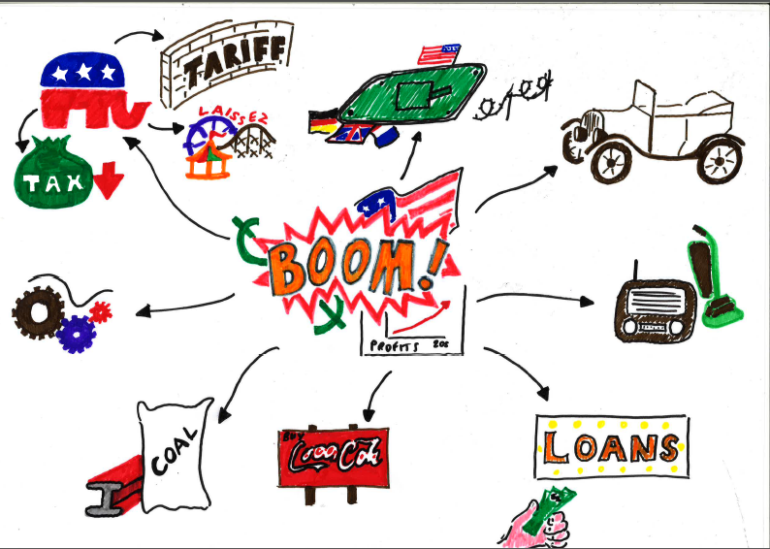
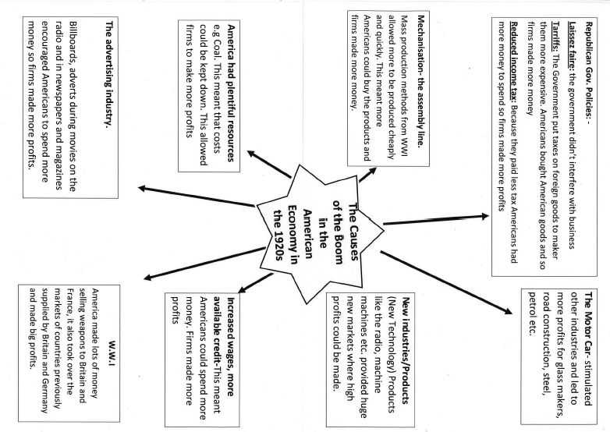
Later you can revisit your notes and turn them into a briefer version- perhaps changing the words into simple pictures that mean something to you- this is a creative process that aids memory.
They can then turn these highlighted areas into a mind map/spider diagram/timeline etc.

Slide 5
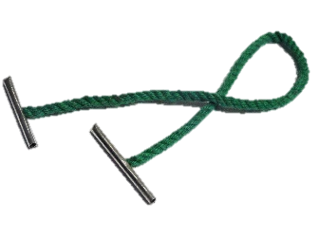
Once completed cards can be hole punched in the corner and tied together with other revision cards for the same topic using string or a treasury tag

Slide 6
Now it is time to get tested! You can give your revision cards to someone else and ask them to test you. If you don’t remember information you can go back to your revision.
If the test is successful you can move to the next area/topic on your revision plan, repeating the process

Slide 7

Other Revision Methods
Stick Post it notes with key facts on, in different places around your house where you will see them as you walk round- E.g. On your mirror, on the fridge etc.
The Area of a Triangle
= Base X Height
2

Slide 8
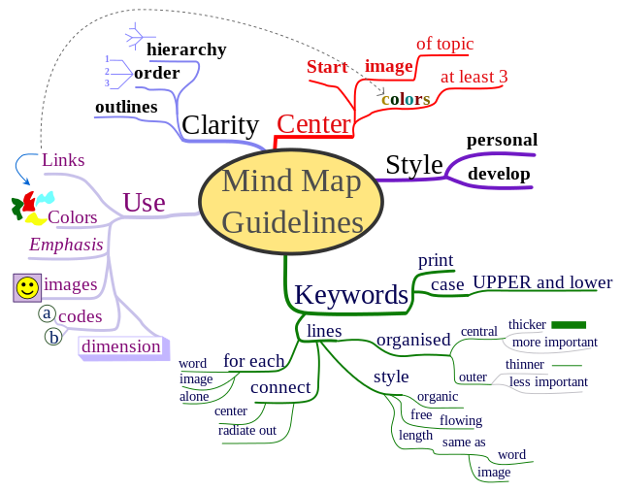
Mind Maps

Slide 9
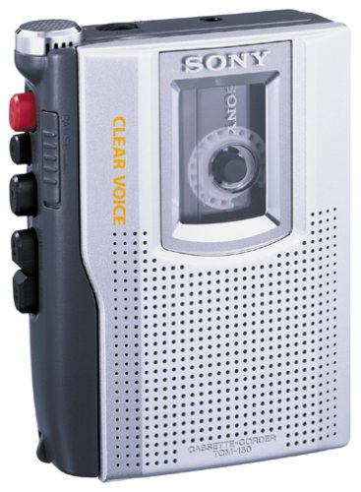
Record yourself reading some key points from notes and play these back when you are travelling/running/just before sleep)
Obviously you’d just use your phone!

Slide 10
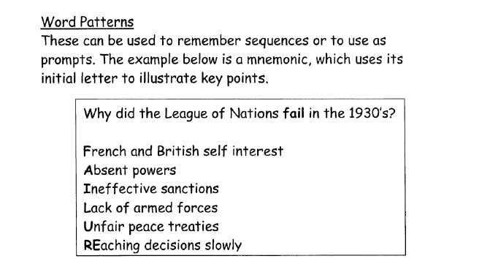
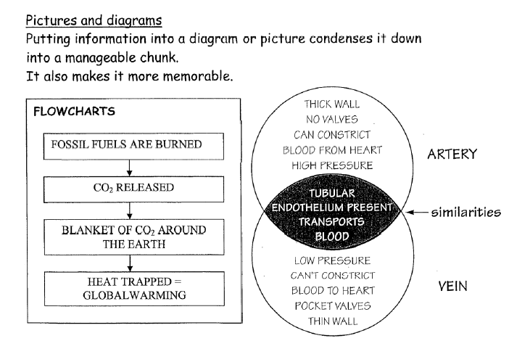

Slide 11
Mnemonics
Here are some you should be familiar with- what others could you think of- the more unusual the better because they’re more memorable!
Richard Of York Gave Battle In Vain
Acronyms
BIDMAS

Slide 12
Picture Stories
Turn information you wish to remember into pictures and create a story to remember them. This is a technique used by people who wish to remember large amounts of information.
Have a go at the exercise on the following 2 slides.

Slide 13

television | Target | Deer | Donuts | Cow
Mousetrap | Mouse | Lobster | Fish Bowl | Cake
Milk | Coombe | scissors | Chair | (Top) Hat
Bear | Present | Elephant | Clown | Bed
5 minutes
You have 5 minutes to turn each word into a picture- after that time your pictures will be taken away from you - how many can you remember now?

Slide 14
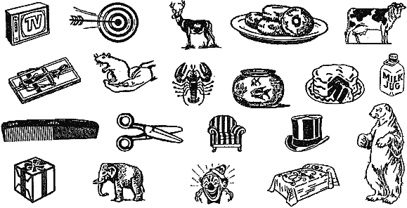
5 minutes
Now use your pictures/words to create a story to help you remember the objects/words in order- does this help?

Slide 15
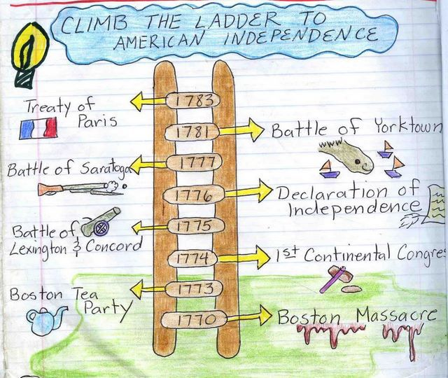
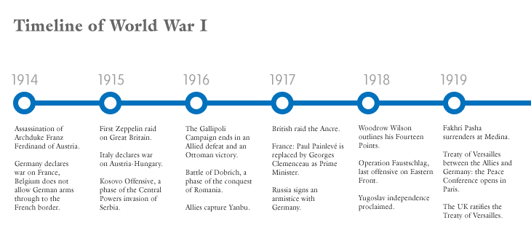
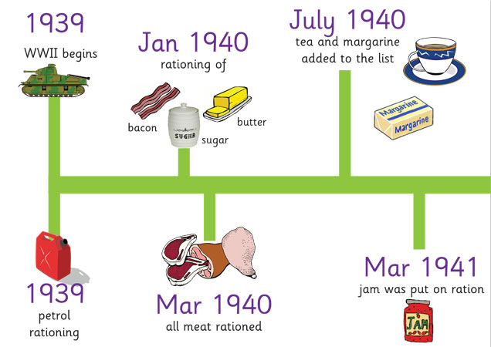
Timelines
These are very good for learning the Chronological order of events.
Adding pictures, colour and being creative will help you to remember more.

Slide 16
So overall- Key Points
We cannot revise until we are clear what we will need to know and we have something to revise from.
We will not be able to revise all the information we need effectively unless we are organised- we need a carefully thought out timetable.
Revision must have a PRODUCT and using different methods is more effective than 1.
Even if we know everything- unless we know HOW to use the information as the examiner wants us to- it will not help.
We must ACTUALLY get on and do it- NOW!

