Slide 1
Summer Homework-English
Literature
Revise the texts we have already studied this year:
‘A Christmas Carol’ by Charles Dickens; ‘Romeo & Juliet’ by William Shakespeare & ‘Power & Conflict’ poetry- AQA Exam Board.
https://www.bbc.co.uk/bitesize/topics/zgq3dmn
Romeo and Juliet - GCSE English Literature - BBC Bitesize
AQA poetry anthology - GCSE English Literature - BBC Bitesize
Create storyboards of the plot, progression charts of the characters and their change, mind-maps of key themes, lists of key quotes.
Make sure the poems you revise are the same ones in your poetry anthologies- Power & Conflict.
Speech preparation for September

Slide 2
Summer Homework-English
Language-Speech preparation for September
Think of at least 3 topics that interest you and complete sheet called ‘Topic Ideas Planning Sheet.’
2) Decide which one interests you the most and collect research on this topic. Complete sheet called ‘Chosen Idea Planning Sheet.’ This must be detailed.
3) Complete worksheet called ‘English Language Section B Exam Task.’
Teachers will be collecting and checking this work when we return-ensure it is completed and brought into your first lesson back. It is essential year 11 preparation work.

Slide 3
Research must be collected over the summer and brought into school for your first lesson back in September. This is essential homework.
Research can include leaflets, images, photocopies from books or from the Internet. The more you have the better your speech will be.
It is suggested you use a folder to keep all of your research safe, ready for when we start this module.

Slide 4

Spoken Language in English
The spoken language presentation needs to be presented in front of the class. This is a condition that is specified by the exam board. For evidence purposes, we need to be able to prove on film that you have performed your presentation to an audience.
TASK OUTLINE: You will be required to speak about your chosen topic for a total of 6-7 minutes.
The presentation will be split into two parts:
Part One: the presentation itself. This will require you to talk about your chosen topic for 3-4 minutes independently.
Part Two: the question and answer session. Students and the teacher will ask you a series of questions based on what they have just heard. You are required to respond to these questions in a thorough and developed way.
This is an important part of your GCSE English Qualification and the grade you achieve (pass, merit or distinction) will appear on your GCSE certificate

Slide 5
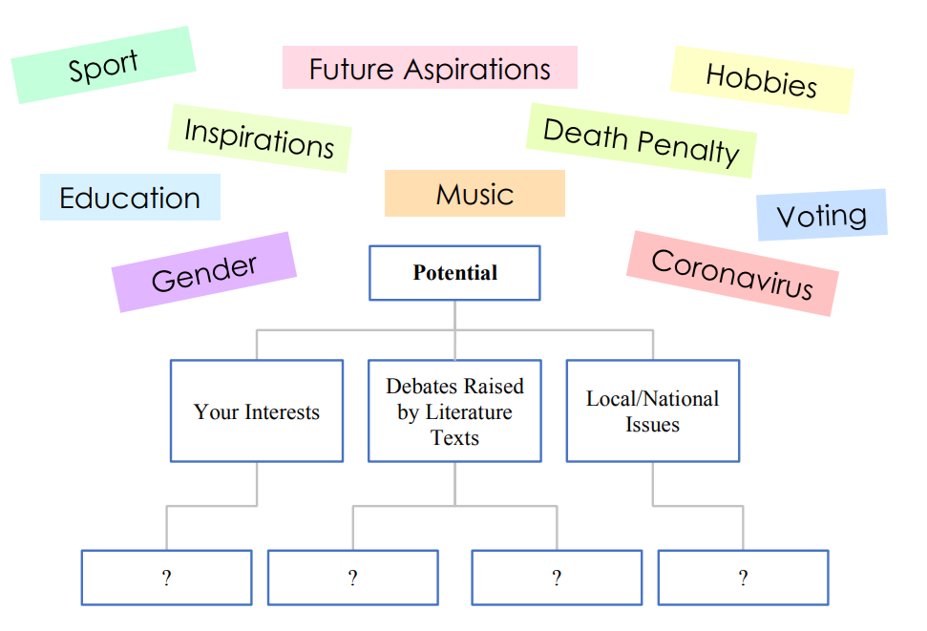
Initial Ideas: Use the mind-map and example topic inspiration below to plan a range of potential topics you could present. Try to write down at least three for each category.

Slide 6
Topic | Topic as a question | Key information already known | Information to find out/research
Gaming | Does playing video games desensitise us? | How I feel when playing video games. Recent stories in the news. | Statistics. Are some games worse than others? Anything in particular?

Slide 7
Choose a topic or question that ENGAGES you (and hopefully your audience)
Be prepared to explain the topic and answer questions about it.
You will need to find EVIDENCE, or SOURCES, to support/ refute your idea. These should be taken from lots of places. Newspapers, websites, images; even fictional texts. You need at least 3 sources.
RESEARCH: Your task is to read, explore and interrogate the materials found.
Be an active reader – question, argue, look further and notice the small details which communicate the writer’s attitudes and feelings.
Consider and articulate your own thoughts and feelings about your topic.
Provoke thought.

Slide 8
Don’t forget DAFOREST!
D Direct address
A Alliteration
F Facts and figures
O Opinion
R Rhetorical question
E Emotive language
S Statistics
T Triple (rule of 3)

